Slide 1


고객가치
새로운 시도
집요한 실행
TSFS source study

Slide 2
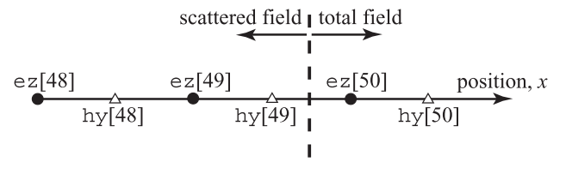
Code example: update H starts first
/* 1D FDTD simulation with a simple absorbing boundary condition
* and a TFSF boundary between hy[49] and ez[50]. */
#include <stdio.h>
#include <math.h>
#define SIZE 200
int main() {
double ez[SIZE] = {0.}, hy[SIZE] = {0.}, imp0 = 377.0;
int qTime, maxTime = 450, mm;
char basename[80]="sim", filename[100]; int frame = 0; FILE *snapshot;
/* do time stepping */
for (qTime = 0; qTime < maxTime; qTime++) {
/* simple ABC for hy[size - 1] */
hy[SIZE - 1] = hy[SIZE - 2];
/* update magnetic field */
for (mm = 0; mm < SIZE - 1; mm++)
hy[mm] = hy[mm] + (ez[mm + 1] - ez[mm]) / imp0;
/* correction for Hy adjacent to TFSF boundary */
hy[49] -= exp(-(qTime - 30.) * (qTime - 30.) / 100.) / imp0;
/* simple ABC for ez[0] */
ez[0] = ez[1];
/* update electric field */
for (mm = 1; mm<SIZE; mm++)
ez[mm] = ez[mm] + (hy[mm] - hy[mm - 1]) * imp0;
/* correction for Ez adjacent to TFSF boundary */
ez[50] += exp(-(qTime + 0.5 - (-0.5) - 30.) * (qTime + 0.5 - (-0.5) - 30.) / 100.);
/* write snapshot if time a multiple of 10 */
if (qTime % 10 == 0) {
sprintf(filename, "%s.%d", basename, frame++);
snapshot = fopen(filename, "w");
for (mm = 0; mm < SIZE; mm++)
fprintf(snapshot, "%g\n", ez[mm]);
fclose(snapshot);
}
}
/* end of time-stepping */
return 0;
}

Slide 3
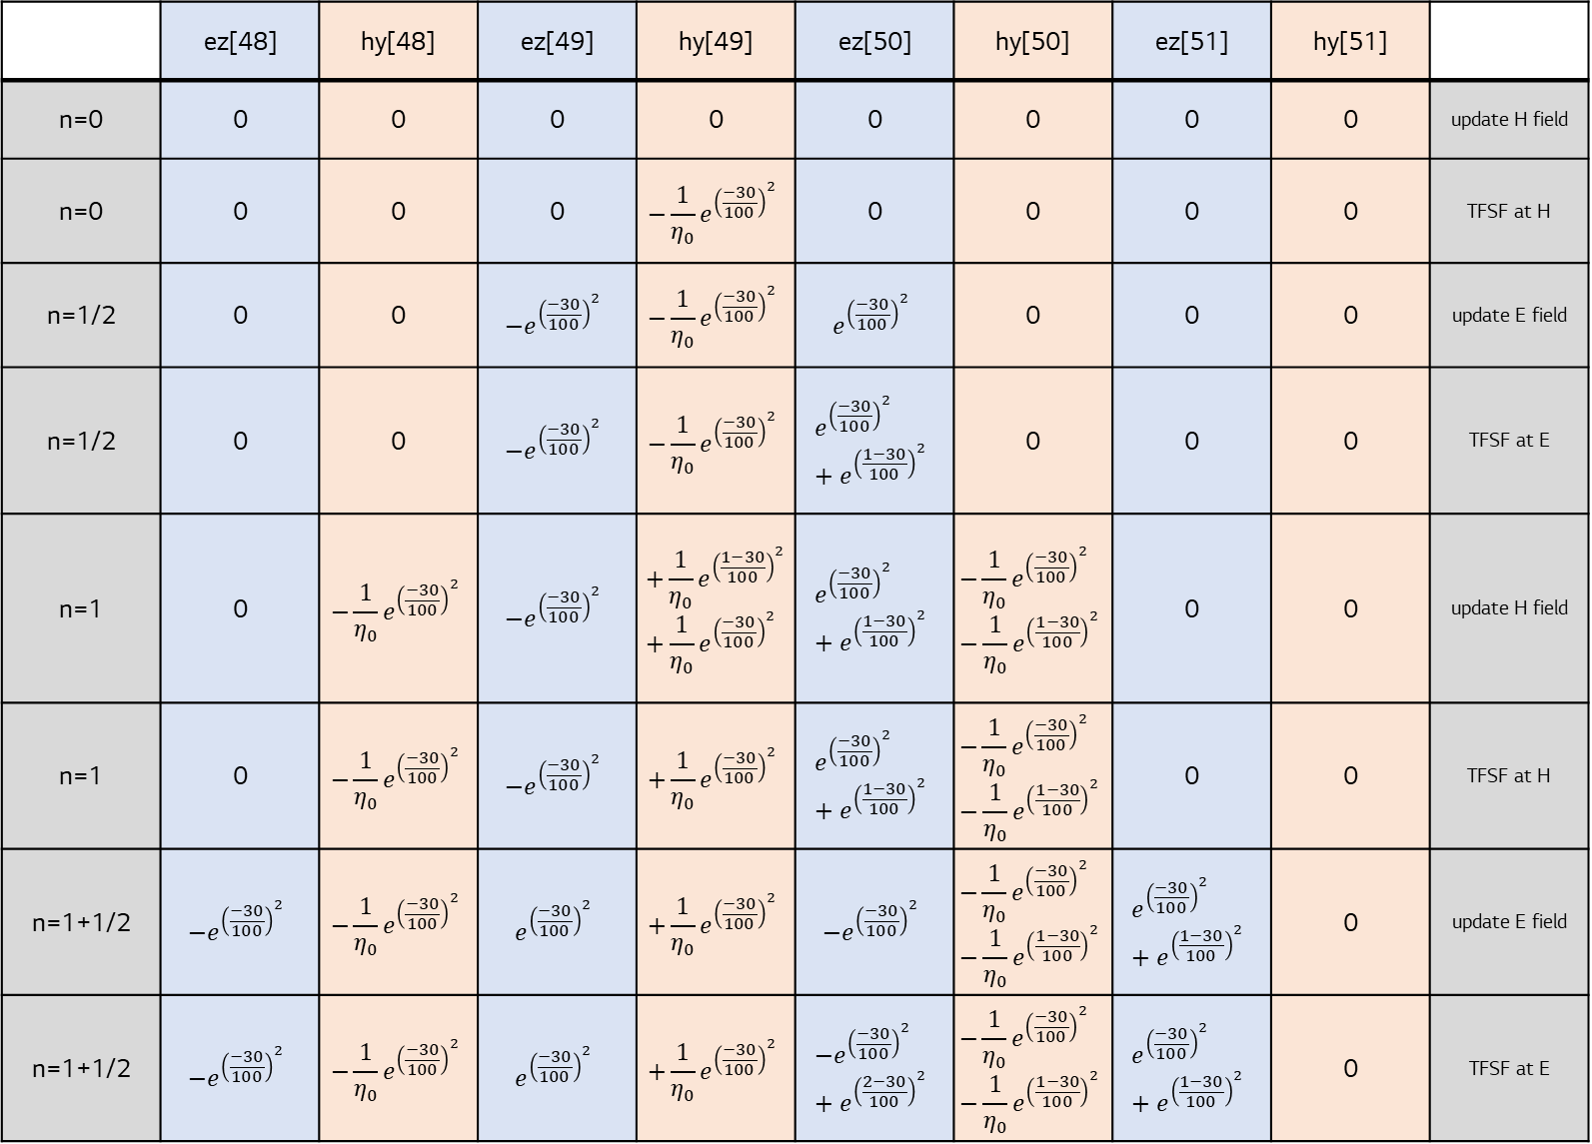
Propagation
 | ez[48] | hy[48] | ez[49] | hy[49] | ez[50] | hy[50] | ez[51] | hy[51]
n=0 | 0 | 0 | 0 | 0 | 0 | 0 | 0 | 0 | update H field
n=0 | 0 | 0 | 0 | $${−\frac{1}{η_{0}}e}^{{\left(\frac{−30}{100}\right)}^{2}}$$ | 0 | 0 | 0 | 0 | TFSF at H
n=1/2 | 0 | 0 | $${−e}^{{\left(\frac{−30}{100}\right)}^{2}}$$ | $${−\frac{1}{η_{0}}e}^{{\left(\frac{−30}{100}\right)}^{2}}$$ | $$e^{{\left(\frac{−30}{100}\right)}^{2}}$$ | 0 | 0 | 0 | update E field
n=1/2 | 0 | 0 | $${−e}^{{\left(\frac{−30}{100}\right)}^{2}}$$ | $${−\frac{1}{η_{0}}e}^{{\left(\frac{−30}{100}\right)}^{2}}$$ | $$e^{{\left(\frac{−30}{100}\right)}^{2}}+e^{{\left(\frac{1−30}{100}\right)}^{2}}$$ | 0 | 0 | 0 | TFSF at E
n=1 | 0 | $$−{\frac{1}{η_{0}}e}^{{\left(\frac{−30}{100}\right)}^{2}}$$ | $${−e}^{{\left(\frac{−30}{100}\right)}^{2}}$$ | $$+\frac{1}{η_{0}}e^{{\left(\frac{1−30}{100}\right)}^{2}}+\frac{1}{η_{0}}e^{{\left(\frac{−30}{100}\right)}^{2}}$$ | $$e^{{\left(\frac{−30}{100}\right)}^{2}}+e^{{\left(\frac{1−30}{100}\right)}^{2}}$$ | $$−\frac{1}{η_{0}}e^{{\left(\frac{−30}{100}\right)}^{2}}−\frac{1}{η_{0}}e^{{\left(\frac{1−30}{100}\right)}^{2}}$$ | 0 | 0 | update H field
n=1 | 0 | $$−{\frac{1}{η_{0}}e}^{{\left(\frac{−30}{100}\right)}^{2}}$$ | $${−e}^{{\left(\frac{−30}{100}\right)}^{2}}$$ | $$+\frac{1}{η_{0}}e^{{\left(\frac{−30}{100}\right)}^{2}}$$ | $$e^{{\left(\frac{−30}{100}\right)}^{2}}+e^{{\left(\frac{1−30}{100}\right)}^{2}}$$ | $$−\frac{1}{η_{0}}e^{{\left(\frac{−30}{100}\right)}^{2}}−\frac{1}{η_{0}}e^{{\left(\frac{1−30}{100}\right)}^{2}}$$ | 0 | 0 | TFSF at H
n=1+1/2 | $$−e^{{\left(\frac{−30}{100}\right)}^{2}}$$ | $$−{\frac{1}{η_{0}}e}^{{\left(\frac{−30}{100}\right)}^{2}}$$ | $$e^{{\left(\frac{−30}{100}\right)}^{2}}$$ | $$+\frac{1}{η_{0}}e^{{\left(\frac{−30}{100}\right)}^{2}}$$ | $$−e^{{\left(\frac{−30}{100}\right)}^{2}}$$ | $$−\frac{1}{η_{0}}e^{{\left(\frac{−30}{100}\right)}^{2}}−\frac{1}{η_{0}}e^{{\left(\frac{1−30}{100}\right)}^{2}}$$ | $$e^{{\left(\frac{−30}{100}\right)}^{2}}+e^{{\left(\frac{1−30}{100}\right)}^{2}}$$ | 0 | update E field
n=1+1/2 | $$−e^{{\left(\frac{−30}{100}\right)}^{2}}$$ | $$−{\frac{1}{η_{0}}e}^{{\left(\frac{−30}{100}\right)}^{2}}$$ | $$e^{{\left(\frac{−30}{100}\right)}^{2}}$$ | $$+\frac{1}{η_{0}}e^{{\left(\frac{−30}{100}\right)}^{2}}$$ | $$−e^{{\left(\frac{−30}{100}\right)}^{2}}+e^{{\left(\frac{2−30}{100}\right)}^{2}}$$ | $$−\frac{1}{η_{0}}e^{{\left(\frac{−30}{100}\right)}^{2}}−\frac{1}{η_{0}}e^{{\left(\frac{1−30}{100}\right)}^{2}}$$ | $$e^{{\left(\frac{−30}{100}\right)}^{2}}+e^{{\left(\frac{1−30}{100}\right)}^{2}}$$ | 0 | TFSF at E

Slide 4
Code example: update E starts first
/* 1D FDTD simulation with a simple absorbing boundary condition
* and a TFSF boundary between hy[49] and ez[50]. */
#include <stdio.h>
#include <math.h>
#define SIZE 200
int main() {
double ez[SIZE] = {0.}, hy[SIZE] = {0.}, imp0 = 377.0;
int qTime, maxTime = 450, mm;
char basename[80]="sim", filename[100]; int frame = 0; FILE *snapshot;
/* do time stepping */
for (qTime = 0; qTime < maxTime; qTime++) {
/* simple ABC for ez[0] */
ez[0] = ez[1];
/* update electric field */
for (mm = 1; mm<SIZE; mm++)
ez[mm] = ez[mm] + (hy[mm] - hy[mm - 1]) * imp0;
/* correction for Ez adjacent to TFSF boundary */
ez[50] += exp(-(qTime + 0.5 - 0.5 - 30.) * (qTime + 0.5 - 0.5 - 30.) / 100.);
/* simple ABC for hy[size - 1] */
hy[SIZE - 1] = hy[SIZE - 2];
/* update magnetic field */
for (mm = 0; mm < SIZE - 1; mm++)
hy[mm] = hy[mm] + (ez[mm + 1] - ez[mm]) / imp0;
/* correction for Hy adjacent to TFSF boundary */
hy[49] -= exp(-(qTime - 30.) * (qTime - 30.) / 100.) / imp0;
/* write snapshot if time a multiple of 10 */
if (qTime % 10 == 0) {
sprintf(filename, "%s.%d", basename, frame++);
snapshot = fopen(filename, "w");
for (mm = 0; mm < SIZE; mm++)
fprintf(snapshot, "%g\n", ez[mm]);
fclose(snapshot);
}
}
/* end of time-stepping */
return 0;
}

Slide 5
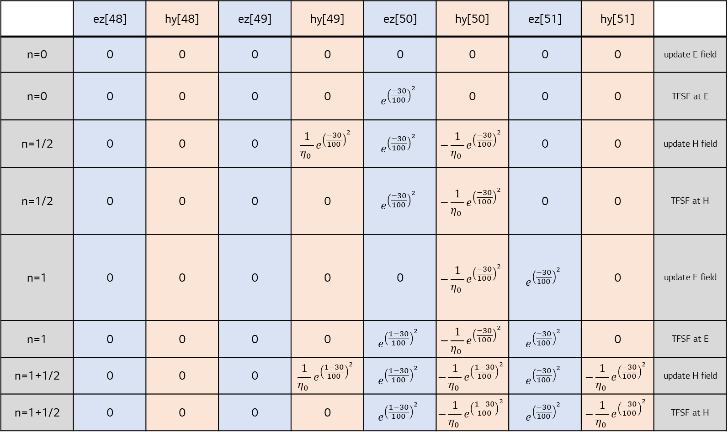
Propagation
 | ez[48] | hy[48] | ez[49] | hy[49] | ez[50] | hy[50] | ez[51] | hy[51]
n=0 | 0 | 0 | 0 | 0 | 0 | 0 | 0 | 0 | update E field
n=0 | 0 | 0 | 0 | 0 | $$e^{{\left(\frac{−30}{100}\right)}^{2}}$$ | 0 | 0 | 0 | TFSF at E
n=1/2 | 0 | 0 | 0 | $$\frac{1}{η_{0} }e^{{\left(\frac{−30}{100}\right)}^{2}}$$ | $$e^{{\left(\frac{−30}{100}\right)}^{2}}$$ | $$−\frac{1}{η_{0} }e^{{\left(\frac{−30}{100}\right)}^{2}}$$ | 0 | 0 | update H field
n=1/2 | 0 | 0 | 0 | 0 | $$e^{{\left(\frac{−30}{100}\right)}^{2}}$$ | $$−\frac{1}{η_{0} }e^{{\left(\frac{−30}{100}\right)}^{2}}$$ | 0 | 0 | TFSF at H
n=1 | 0 | 0 | 0 | 0 | 0 | $$−\frac{1}{η_{0} }e^{{\left(\frac{−30}{100}\right)}^{2}}$$ | $$e^{{\left(\frac{−30}{100}\right)}^{2}}$$ | 0 | update E field
n=1 | 0 | 0 | 0 | 0 | $$e^{{\left(\frac{1−30}{100}\right)}^{2}}$$ | $$−\frac{1}{η_{0} }e^{{\left(\frac{−30}{100}\right)}^{2}}$$ | $$e^{{\left(\frac{−30}{100}\right)}^{2}}$$ | 0 | TFSF at E
n=1+1/2 | 0 | 0 | 0 | $$\frac{1}{η_{0} }e^{{\left(\frac{1−30}{100}\right)}^{2}}$$ | $$e^{{\left(\frac{1−30}{100}\right)}^{2}}$$ | $$−\frac{1}{η_{0} }e^{{\left(\frac{1−30}{100}\right)}^{2}}$$ | $$e^{{\left(\frac{−30}{100}\right)}^{2}}$$ | $$−\frac{1}{η_{0} }e^{{\left(\frac{−30}{100}\right)}^{2}}$$ | update H field
n=1+1/2 | 0 | 0 | 0 | 0 | $$e^{{\left(\frac{1−30}{100}\right)}^{2}}$$ | $$−\frac{1}{η_{0} }e^{{\left(\frac{1−30}{100}\right)}^{2}}$$ | $$e^{{\left(\frac{−30}{100}\right)}^{2}}$$ | $$−\frac{1}{η_{0} }e^{{\left(\frac{−30}{100}\right)}^{2}}$$ | TFSF at H

